Slide 1
University of Basrah College of Medicine/ Department of Human Anatomy First Class Medical Biology

Slide 2
Glandular Tissue
Balqees Alasfoor

Slide 3
Objectives
To know what are the glands
Structure
Types
Location and functions

Slide 4
Epithelial glands
Are structures derived from epithelial cells that specialize in producing secretion.
They usually develop as invagination / in growths into the underlying connective tissue .

Slide 5
Types of glands:
During fetal development epithelial cells
proliferate and penetrate the underlying connective tissue .
they may or may not maintain connection with surface epithelium.
When the connection is maintained , exocrine glands are formed , with the connection lost endocrine glands are formed.

Slide 6
A
b
a

Slide 7
So the glands classified into three major groups on the basic of method of distribution of their secretary products to :
1-Exocrine glands :
Are derived from specialize epithelial cells have secretory portion and ducts that transport the product to the exterior of the glands .

Slide 8
The duct may be made of squamous to stratified columnar cells
The secretory portion may be shaped like test tube (tubular) or as a flask (acina) which is a small ball of secretory epithelial cells containing a tiny central lumen .

Slide 9
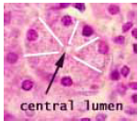
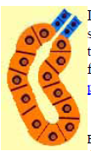
duct
Acina
Secretory portion
Tubular

Slide 10
Functions of exocrine glands
Regulate body temperature
Sweat gland
Lubricate
Meibomian glands in eye
Nurture newborns (lactation)
Mammary gland
Aid in digestion, and aid in reproduction.
Salivary gland and gonads.

Slide 11
2-Endocrine glands
Derived from specialized epithelial cells but the connection to the exterior duct has disappeared.
Endocrine cells are typically aggregate as
1-Cords which passes their secretion into blood vesicles such as( adrenal gland).
2-Follicle which is epithelial cells called follicular cells surround a cavity or vesicle fill with non cellular material called ( hormone) and also passes their secretion into blood vesicles.

Slide 12
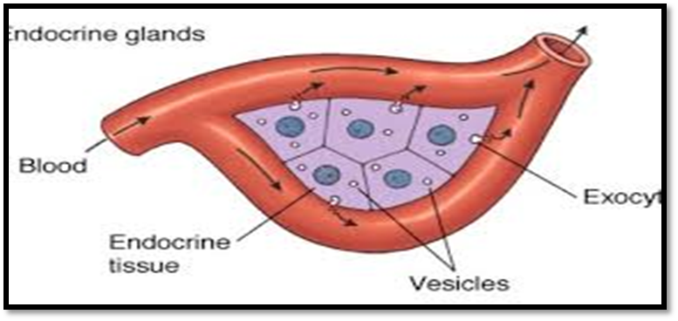

Slide 13
Functions of endocrine glands
Control the hormone production where the hormones stay in the gland until the body calls on them
Pituitary gland, ovaries, testes, thyroid gland, parathyroid gland and adrenal gland.

Slide 14
3- Mixed glands :
In this glands group of cells secreted into duct and another group of cell secrete into blood stream e.g. (pancreas, liver ,ovary)

Slide 15
Classification of exocrine glands
Exocrine glands can be classified into different types of glands according to various criteria :
A-The glands are classified according to the number of the cells into :
1-Unicellular glands :
Isolated secretory cells located in anon secretory epithelium,
Example, Goblet cells among absorption cells in intestinal epithelium

Slide 16
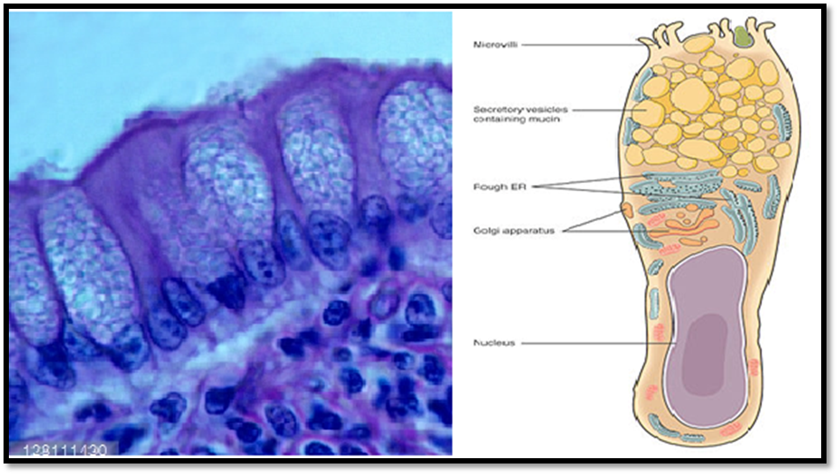
Goblet cells in intestine
Basal n.

Slide 17
2-Multicllular gland
a-Simple gland :
Duct portion is unbranched ( the secretory portion attached to the duct may be branched)
b-compound glands :
Have duct that branch repediatly, the secretory portion can be tubular (pyloric stomaic) acinar (pancreas) or tubuloacinar ( prostate).

Slide 19
B- The glands are classified according to the type of secretion :
1-Mucous glands :
cells which are specialized to secrete mucous called mucous cells .
E.g. esophageal glands and goblet cells , the cells are typically organized into tubular secretory units .

Slide 20
Mucous glands are distinguished by empty appearing (pale staining ) apical cytoplasm and densely stained basal nuclei.

Slide 22
2-Serous glands :
Serous cells are distinguished by basophilic basal cytoplasm.
A spherical, near to the base –located nucleus
Variously – staining secretory vesicles in apical cytoplasm
product watery solution of enzymes like serum or else glycoprotein mixture (mucous like mucin).
serous cells specialized to secrete enzyme solution e.g. salivary gland.

Slide 23
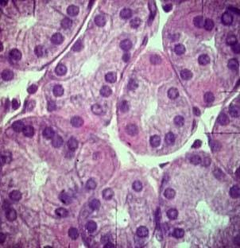

Slide 24
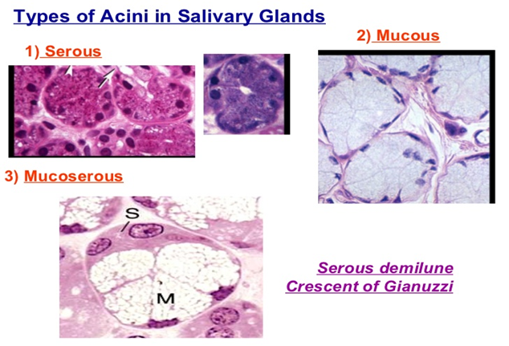
3-Mixed glands:
Containing both mucous and serous cells .

Slide 25
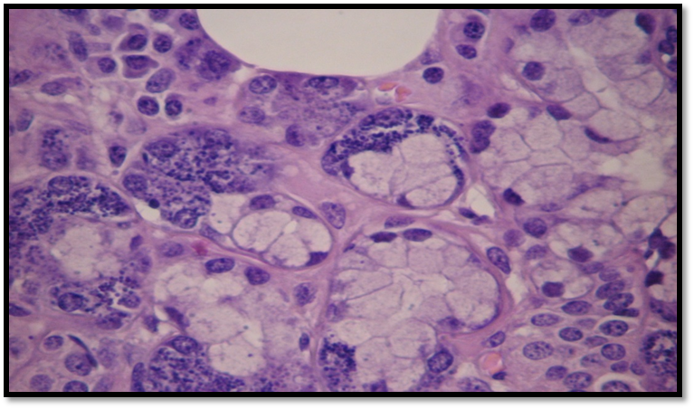
M.G
Serous glands
Mucous glands

Slide 26
Differences between mucous and serous glands
Clusters of serous cells are called serous acini, while the clusters of mucous cells are called mucous acini.
Serous acini have narrow lumen while mucous acini have wider lumen.
In H and E- stain, mucous cells appear pale blue, unlike the serous cells.

Slide 27
Nucleus of serous cell is spherical and situated near to the base of the cell, while the nucleus of the mucous cell is more flattened and situated on the base of the cell.
Mucous acini are composed of larger cells than serous acini which are composed of smaller cells.
Mucus is thick and viscous fluid, whereas serous is more watery and less thick.

Slide 28
Serous contains amylase enzyme, whereas mucus contains little or no enzymes.
Serous helps to digest starch, while mucus mainly serves as lubricant and protection layer.

Slide 29
C-Classification according to mode of secretion :
1-Merocrine
Most exocrine glands are merocrine , the secretory granules ( usually protein) leave the cells by exocytosis at the apical end of secretory cells with no loss of other cellular material.

Slide 30
Merocrine glands: Pancreas & Salivary glands

Slide 31
2- Holocrine :
The secretions accumulate in each cell's cytoplasm and release the whole cell into the duct and that can destroy the cell, which is replaced by a new growth cell.
Example: Sebaceous gland .

Slide 32
Holocrine glands: Sebaceous glands in skin of mammals

Slide 33
3-Apocrine :
The secretory material is released along with apart of apical cytoplasm in the form of (blebs).
The rest of the cells is intact and continuous to function
Example: Sweat glands.

Slide 34
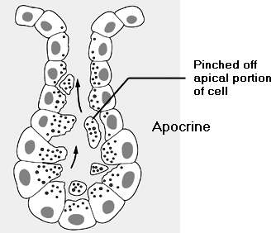
Apocrine glands: Mammary glands

Slide 35
Apocrine secretion is less damaging to the gland than holocrine secretion (which destroys a cell) but more damaging than merocrine secretion (exocytosis).

Slide 36
Myoepithelial cells :
Present around the secretory acini and surrounding the ducts.
Cells are located between the basal portion of the secretory cell and the basal lamina , and its cytoplasm contains numerous actin filaments as well as myosin.
These cells have contract function.

Slide 38
Conclusion
Glandular epithelial cells make up the glands in the body.
The functions of glandular epithelium cells depend on their location in the body.
Exocrine glands hold secretions for organ linings and coverings until they are needed.

Slide 39
The exocrine glands secrete their products into a duct that then delivers the product to the lumen of an organ or onto the free surface of the epithelium.
Endocrine glands control the hormone production, the hormones stay in the gland until the body calls on them.
It secretes its essential product without the use of a duct directly into the bloodstream or else by diffusion into its surrounding tissue where it often affects only target cells near the release site.

